Slide 1
Final Exam Project
By: Joey Cawley

Slide 2
Video Game Simulation
Program uses Java swing to simulate a “chest” open within a video game
Once the user has clicked the open button, a randomly generated item (Color and Type)
Then the program will ask the user if he wants the item added to his inventory
And lastly a “save” file is created adding your inventory to a saved text file

Slide 3
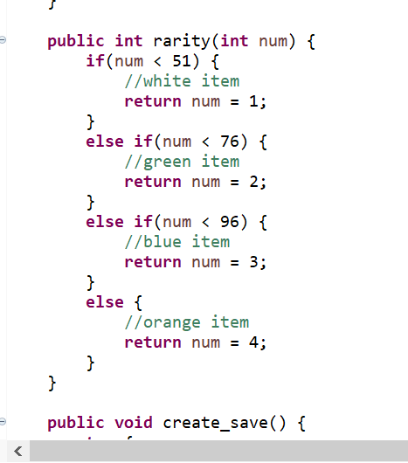
Item Rarity
Random number generator takes a number 0-99 and sorts each item into a range group.
Each weapon is rarer than the next
White-Green-Blue-Orange (Orange being the most uncommon)

Slide 4
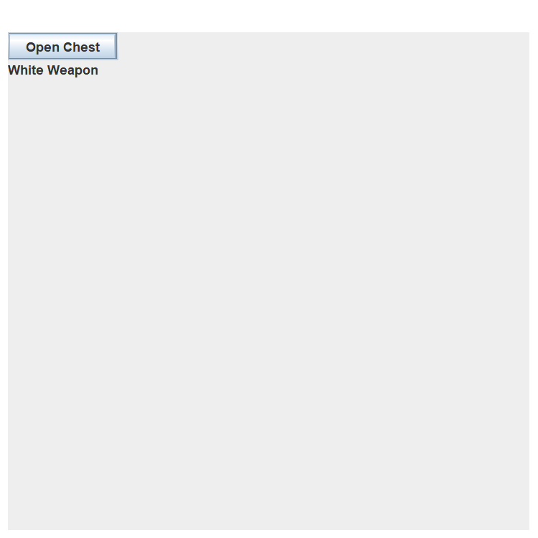
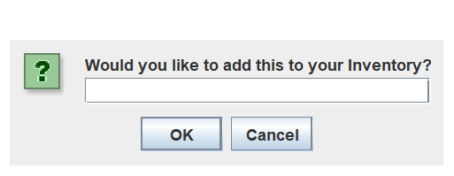
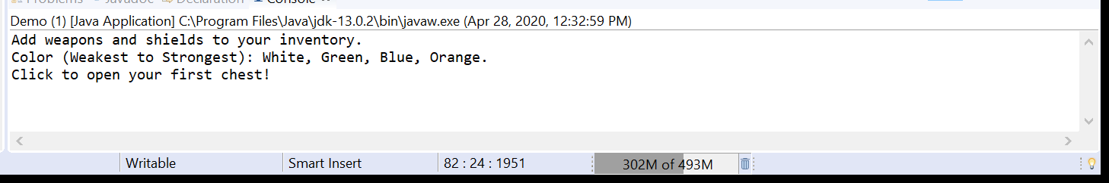
Open Chest Button, Inventory Input, and Start Message

Slide 5
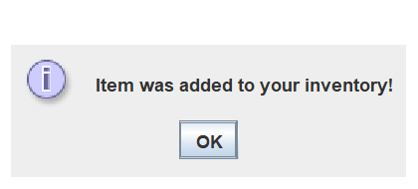

If yes is clicked, item is added to your inventory and a “save” file is created

Slide 6
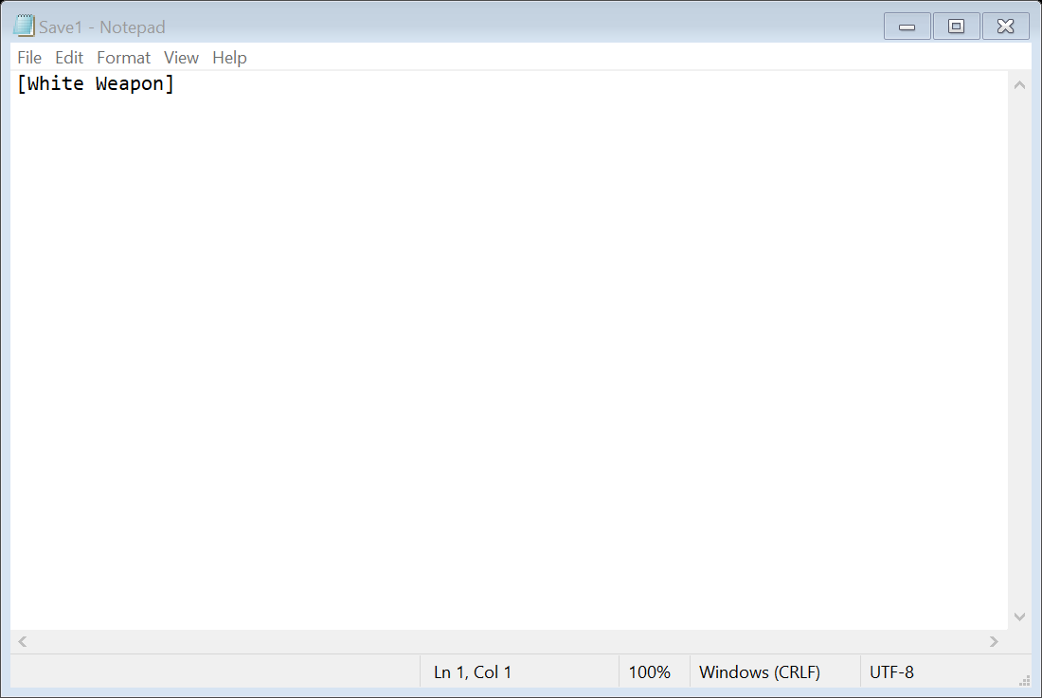
Save File (White Weapon in inventory)

